Slide 1
MD & HODs
H&S leadership
Leading H&S
MD and HODS
Abigail Bainbridge/ Andrew Marvin/
Barry Gorman/ Tom Weller
Date
October/ November 2023

Slide 2


Agenda
What we are going to cover today
11am – 12pm: Abigail Bainbridge – the foundations of leading H&S
12pm – 12.15pm: 15 min break
12.15pm – 1.15pm: Andrew Marvin – insurance programme and claims cost control
1.15pm – 1:45pm: lunch
1.45pm – 2.45pm: Barry Gorman – Leading H&S & Persimmon
2.45pm – 3.15pm: Tom Weller – Building Safety
3.15pm – 3.30pm: Questions and close

Slide 3
The foundations of leading H&S
Leading H&S
MD and HODS
Abigail Bainbridge
Group HS&E Director
Date
October/ November 2023

Slide 4
INTRODUCTION
Leading H&S – the foundations
The moral, legal and financial case
Plan
Do
Check
Act
Take away/ personal commitment

Slide 5
The moral, legal and financial case
What we will look at
Cost of poor H&S at work
Benefits of good H&S performance
Key health and safety legislation
Corporate social responsibility
Three essential principals
Health and safety management systems

Slide 6

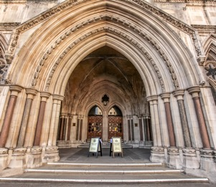

Cost of poor H&S at work
What do we think?
INJURIES & ILL- HEALTH
  Effects on the person and connected people
  Possible prosecution
  Likely civil action
  Bad publicity/ loss of business
  Workforce confidence
  Lost work time (not just the person)
Moral
Legal
Financial
Civil & Criminal
Insured & Uninsured

Slide 7
Cost of poor H&S at work
HSE stats, what do we think?
Fatal injuries in construction – common cause?
30 fatal injuries to workers
and 5 members of the public in 2021/2022
Source: RIDDOR, 2021/22

Slide 8
Cost of poor H&S at work
HSE stats, what do we think?
Non fatal injuries in construction – common cause?
Source: Labour force survey (LFS)
59,000 non-fatal injuries to workers averaged over 3 years. 2019 - 2022

Slide 9
Cost of poor H&S at work
HSE stats, what do we think?
Ill health in construction – common cause?
An estimated 21,000 work-related cases of stress, depression or anxiety (new or longstanding) 27% of all ill health in construction sector
Source: LFS, estimated annual average 2019/20-2021/22
)
There were an estimated 42,000 work-related cases of musculoskeletal disorder (new or longstanding) 53% of all ill health in the construction sector.
Source: LFS, estimated annual average 2019/20-2021/22
78,000 workers suffering from work-related ill health (new or long-standing)
Averaged over the three-year period 2019/20-2021/22
Source: LFS estimated annual average 2019/20-2021/22
Notes:
In most other industries musculoskeletal disorders and stress, depression and anxiety percentages are usually the other way around? Why do you think the construction industry is different? Less issues with SD&A?

Slide 10



Key health and safety legislation
CRIMINAL LAW
CIVIL LAW
Health & Safety at Work (etc.) Act 1974
Employers duty
Duty to non-employees
Manufacturers and suppliers duty
Employees duties
Common Law
Duty of care
Breach of duty
Harm caused
Offences can be committed by:
A corporate body
Director or senior manager through their consent, connivance and neglect
Consequence
Company – enforcement notices and unlimited fine
Individuals – fine or imprisonment (max 2 years)
Companies Act/ Companies Director Disqualification Act
Corporate Manslaughter & Corporate Homicide Act
Notes:
Other relevant legislation –
Company Directors Disqualification Act – companies house names directors following conviction of an indictable (serious) H&S offence can be disqualified for up to 15 years.
Corporate Manslaughter and Corporate Homicide Act – company convicted if a failing in management systems which caused the death and the failing was at senior level which amounted to cross misconduct ‘far below what was reasonably expected’
Companies Act – duties on companies house directors to take all reasonable steps to comply with H&S law.

Slide 11
Key health and safety legislation
Key employer responsibilities under the HSWA
Heath and safety policy
Risk assessments
Manage health and safety
Access to competent H&S advice
Provide employees with information, instruction, training and supervision (be competent)
Consult with employees

Slide 12
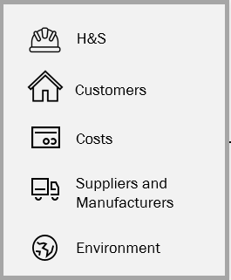

Corporate social responsibility
Duty – protect the business and stakeholders from risk

Slide 13
Three essential principals
Strong and active leadership
Visible and active commitment to H&S
Effective downward communication arrangements and management structures
Integration of good H&S management with all business decisions

Slide 14
Three essential principals
Worker involvement
Engagement of the workforce in the promotion and achievement of safe and healthy conditions
Effective upward communication channels
High quality training in H&S

Slide 15
Three essential principals
Assessment and review
Health and safety risks identified and managed
Access to competent H&S advice and following this
Effective arrangements in place for monitoring, reporting and reviewing performance
Notes:
Look at yourself and make sure as a leader you can tick off that you do all those things. If not then consider how you can make improvements to ensure you are covering this.

Slide 16
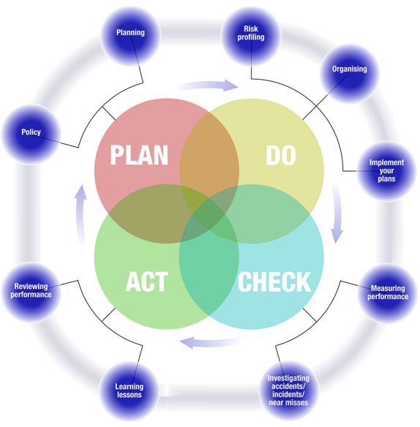
Health and safety management systems
Plan, Do, Check, Act
Leadership drives the cycle through:
Planning – think about where you are now and where you need to be
Doing – organise how you will deliver your plan and implement it
Checking – measure your performance to see whether or not your plan was effective
Acting – take action if your plan was not effective and go through the cycle again
Notes:
The majority of H&S management systems are based on the PDCA cycle (including ours)
It’s included in guidance from the HSE and the Institute of Directors – ‘leading H&S at work’
Also links in with ISO 45001

Slide 17
Plan
Planning
Determining the H&S policy
Planning to implement the policy
To plan successfully, need to establish
Where the organisation is now, by considering accurate information about the current situation
Where it needs to be, using legal requirements and benchmarking to make comparisons
What action is necessary to reach this point
Notes:
Exercise going through as a Dept. with the release of the new policies and standards

Slide 18
Actions to take
Actions, change, things
Things to consider
Statement of intention – saying what you will do to keep a safe and healthy environment for your workers and everyone
Setting out everyone’s roles and responsibilities
Saying how things will be done and what resources will be allocated
Consider how H&S performance measured
Consulting with employees on H&S matters
Putting H&S at the top of every meeting agenda
A
C
T
Notes:
MDs sign policy statements but MDs/ HODs pivotal in communicating what we are doing
Directors/ HODs sign directors responsibility chart and there is the H&S policy which generally sets H&S R&Rs. However, individual job descriptions and setting of expectations at the outset with an employee need to include specific individual responsibilities for H&S
H&S policy/ standards say how things will be done but also local rules and procedures say how things are done. You are all responsible for directly influencing how resources allocated
We give all the H&S stats from a Group/ operating business level but you can also consider other way to measure H&S performance.

Slide 19
Do
Organising
Organising for health and safety covers four key areas
Control
Co-operation
Communication
Competence
Achieved through:
Leadership
Management
Supervision
Performance standards
Instruction
Motivation
Accountability
Rewards
Sanctions
Between workers, their representatives and management through active consultation and engagement
Across the whole organisation, through visible behaviour, written material and face to face discussion
Achieved through:
Recruitment
Selection
Training
Coaching
Specialist advice
Avoiding complacency

Slide 20
Do
Risk profiling organisational risks
Effective Leaders:
Know the risks their organisation/ department face
Rank them in order of importance
Take action to eliminate, reduce or control them
Risk profiling - little value unless put into action!
Each Dept. facing different risks.
Notes:
Each Dept. will be facing different risks, tell me what your think your highest H&S risks are:
Sales
Customer Care
Technical
Construction
Commercial

Slide 21
Actions to take
Actions, change, things
Things to consider
Making sure everyone is competent to perform the tasks required of them
Making sure everyone has sufficient resources available to them to deal with H&S issues
When engaging contractors, making sure they know what is expected of them, the importance of H&S, to support management decisions to stop work if something is not safe and that they are prepared to address unsafe practices
Look at risks, check that minor risks have not been given too much priority and that significant risks have not been overlooked
A
C
T

Slide 22
Check
Proactive and reactive
Measuring performance
Investigating accidents
External changes
Effective monitoring system
Sensible measures
Not just a tick box exercise
Help identify problems
Determine changes
Needs to be timely
Reported back
Proactive or reactive
Learn lessons
Determine cause
Prevent happening again
Monitor for trends
Comply with the law
Inform HSE if RIDDOR
Establish cost of accident
Don’t forget near misses
New/ changed legislation
Change in best practice
New/ revised industry standard
New/ revised product
New technology
Notes:
Proactive – site inspections
Reactive – monitoring accident/ incident rates
In the 90’s 2 Americans did a study of accidents and found for every 1 major injury there are 10 minor injuries, 30 property damage accidents and 600 near misses.
Remember Paddington Rail crash in 97 – prior to the accident there were 8 near misses at the accident location and signal 109 had one of the highest number of SPADS (signal passed at danger) on the rail network

Slide 23
Actions to take
Actions, change, things
Things to consider
Ensuring that systems are in place to report performance upwards, so that you as leaders can review and be assured that legal compliance is achieved and maintained
Making certain there is a process in place to report accidents/ incidents and near misses upwards immediately
Receiving and review of reports at regular intervals
Questioning results and ensure that action is taken to tackle poor performance
Process to consider lessons learned following accidents
A
C
T

Slide 24
Act
Act on the information you review and learn lessons
Reviewing performance
Learning lessons
Learning lessons involves acting on
Issues identified in incident/ near miss reporting
Findings identified during monitoring, audits and reviews
Learning lessons might necessitate changes to:
H&S policy and procedures
Roles and responsibilities of personnel
The way in which a task is done
Premises, equipment and materials used
Documentation and information systems
Way performance is monitored and managed
Carrying our reviews will confirm:
The validity of your H&S policy
Ensure the system you have is effective
See how the H&S environment in your business has changed, enabling you to stop doing the things that are no longer necessary or respond to new risks
Celebrate and promote your H&S success
Closes the PDCA loop

Slide 25
Actions to take
Actions, change, things
Things to consider
Asking for regular reviews of things affecting H&S
Making sure that a report is issued to senior leaders for consideration and possible further action
Ensuring the scope of the review gives assurance that risks are as low as reasonably practicable and that your organisation is complying with H&S law
Showing by your actions that safety is a core value
Promoting a questioning attitude around H&S
Resolving ineffective procedures that result in ‘workarounds’
Avoiding complacency – take responsibility for keeping your own knowledge and capability up to date
A
C
T

Slide 26
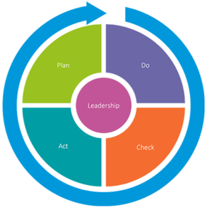
The importance of leadership
“Safety isn’t expensive, its priceless”
There are three interrelated aspects to human factors that have a significant influence on behaviour
The organisation
The job
The individual
Work patterns
Culture
Resources
Communications
Leadership
The task
Workload
Working environment
Design of controls
Role of procedures
Competence
Skills
Personality
Attitude

Slide 27
The importance of leadership
“It takes leadership to improve safety”
What style of leadership do you think is generally regarded to be the most influential?
Transformational leaders are generally regarded to be the most influential, they
Lead by example
Communicate clear H&S messages with integrity
Empower followers to make decisions
Use praise, rather than criticism
Coach people, rather than instruct them
Encourage people to voice H&S concerns, taking action when they do
Transformational leaders:
Work to enhance the motivation and engagement of followers by directing their behaviour towards a shared vision
Transactional leaders:
Focus on the role of supervision, organisation and group performance. They are concerned about achieving compliance and day to day progress towards goals

Slide 28
Set a personal commitment
Set a personal commitment for H&S by identifying outcome, performance and process goals
Outcome goal
What is it you are ultimately trying to achieve by making the commitment
Performance goal
How achievement of the goal will be measured
Process goal
What the activity steps are that you will take to achieve the goal
Notes:
Only a couple of bullet points for each section
Example
Outcome goal – reduce slip, trips and falls on sites across the business
Performance goal – slips, trips and falls accident rate reduces
Process goal - enforce housekeeping standards that each site might follow including a process to issue clean up notice to sub-contractors.
Ask site managers to complete a safety campaign around having a tidy sites. This would include posters and asking site management to undertake Tool Box Talks with all operatives.

Slide 29
Thank you
Questions?

Slide 30



Insurance Programme
& Claims Cost Control
Keeping people safe
Andrew Marvin | Account Director | Gallagher

Slide 31
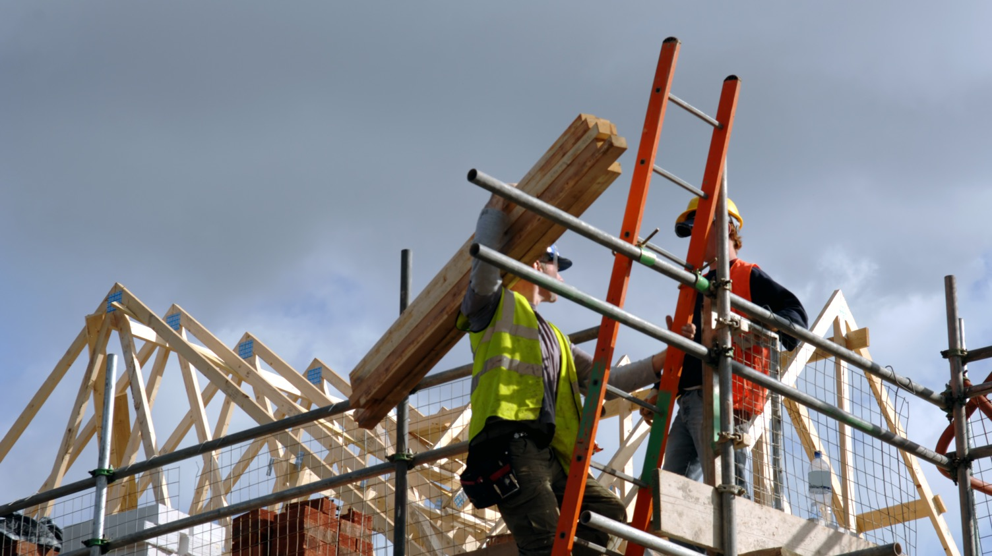
What is insurance?

Slide 32


What is insurance
1. What is insurance?
Returns you back to the same financial situation as you were before the loss!
3. Can you insure all risks?
No! Key risks can be insured, but things you control such as defective works are your own costs
2. Why do you insure?
Protection of your P&L

Slide 33
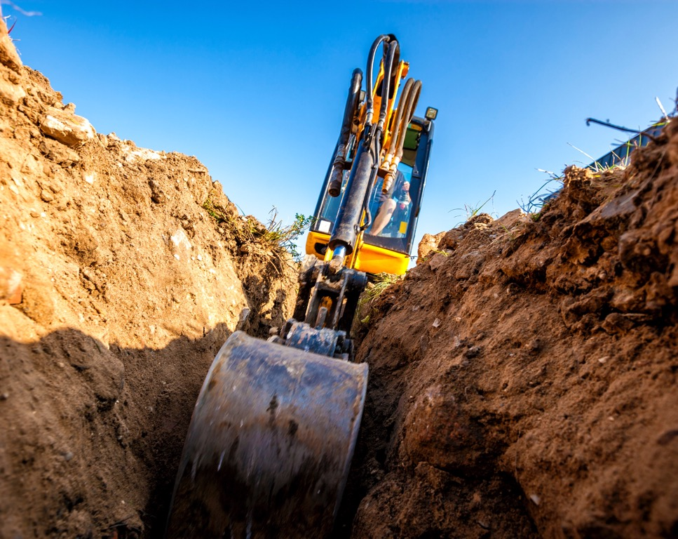
What is insurance
Contractors combined
Public and Product Liability
Limit £35,000,000
Excess £50,000 per claim (with a global cap)
Employers Liability
Limit £35,000,000
Excess Nil
(employees and labour only)
Contract Works
Limit £35,000,000
Excess £50,000 per claim

Slide 34


What is insurance
Fleet
Property
All cars, vans & road going plant
Approx. 800 vehicles covered
Excess
£2,500 per claim for own damage
£10,000 for theft of plant
£2,500 for damage to TP by plant on site
Offices, contents, additional buildings
Approximately £350m sum insured –
needs to be kept up to date
Excess
£25,000 per claim for any damage

Slide 35

What is insurance
Why are the excesses so large?

Slide 36
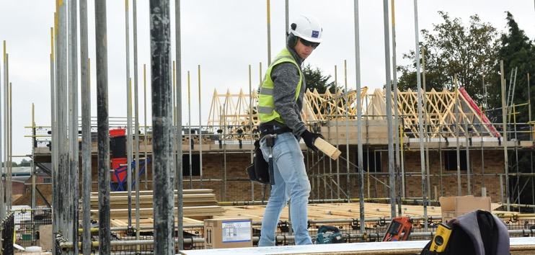
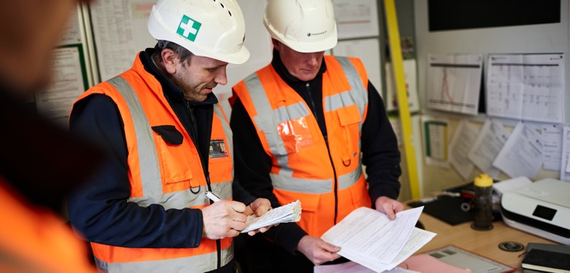
What is insurance
When should insurers be informed?
Anything that might make a claim should be reported
Group should be advised of larger losses
Failure to report can leave you with no cover
It could also affect the wider group covers

Slide 37
Reducing Claims Costs
Delays in reporting motor incidents
impacts costs & premiums
CLAIM NOTIFICATION VERSUS THIRD PARTY COST
Scenario: Insured driver hit rear of stationary Third Party (TP) vehicle. Moderate damage caused. TP was driving a Ford Focus. Whiplash sustained by TP driver
Notified on | Notification | Repair | Hire | Personal Injury (PI) | Total Cost*
Day 1 | METHOD: Over the phone by insured driver. Full contact details for TP provided. OUTCOME: Allianz makes immediate call to TP. The early notification increases the chances of Allianz obtaining complete control of the claim. Allianz will handle all elements of the TP claim directly. | TP accepts offer of repair through Allianz approved repairer network. Vehicle collected within 24 hours. Repair length monitored. Costs reduced due to Allianz's agreed rates. | TP agrees to use Allianz's preferred supplier of hire vehicles. | Proactive call identifies that TP has suffered a whiplash injury. Allianz offers to deal directly to avoid legal costs. This is accepted by the TP. Allianz arranges physiotherapy and commissions a medical report. | £5,000
 |  | Estimated repair outcome: £1,500 | Estimated hire outcome: £500 | Estimated Pi outcome: £3,000
Day 5 | METHOD: Over the phone by insured's fleet manager. Only name and registration number of TP provided. OUTCOME: Unable to talk to TP directly, we have to speak to TP Insurers. | TP has gone to their own insurers to arrange repairs. TP insurer does not apply their repairer discounts to claims where they can recover their money from another party as they would for a fault claim. As Allianz cannot negotiate a reduction in repair costs and rates, costs increase. | TP has been referred to a credit hire company by their insurers to get a hire car for the duration of time the vehicle is being repaired / replaced. | TP has instructed solicitors to pursue the injury daim. They have submitted a claim through the MOl Portal, arranged physiotherapy and commissioned a medical report. | £7,500
 |  | Estimated repair outcome: £1,800 | Estimated hire outcome: £1,700 | Estimated Pl outcome: £4,000
Day 15 | METHOD: Email notification by insurance broker. Claim form to follow with full details. OUTCOME: We have to await accident report form to fully confirm validation and fault. | As we cannot confirm our position on liability, the TP insurers cannot waive the TP excess. The TP does not wish to pay their excess for an accident that is not their fault, so goes into credit repair, therefore can drive up costs as the vehicle is repaired on credit. | TP is in credit hire. Due to the delay in reporting there is an increased risk that we are unable to make a payment of hire within 30 days, resulting in penalty charges accruing. | There is an increased risk that Allianz cannot confirm their position on liability within the 15 days allowed for investigation in the MOl process, in which case it will drop out and costs will increase. The solicitors are likely to use a more experienced solicitor who may bring in more complex types of claim. | £11,500
 |  | Estimated repair outcome: £2,600 | Estimated hire outcome: £1,700 | Estimated Pl outcome: £6,500
Day 30 | METHOD: Claims notification received from the TP solicitors through the MOM Portal. OUTCOME: Numerous chasers for report from the customer's broker and no details received for three months. This puts the customer at risk in terms of cover provided. | Storage of the TP vehicle accrues due to Allianz being unable to confirm their position on both cover and liability. TP goes to a credit repairer. | As Allianz are unable to admit liability within 90 days, the hire charges fall into commercial rates. The period of hire is also greatly increased as Allianz cannot confirm cover or liability until the customer reports the matter. | Allianz cannot confirm liability within the 90 day investigation period permitted under the Pl protocol. As such the claim is passed to the TP's solicitor's litigation team to prepare the matter for court. All types of loss will be induded and damages maximised to increase costs. | £20,000
 |  | Estimated repair outcome: £4,000 | Estimated hire outcome: £7,500 | Estimated Pl outcome: £6,500

Slide 38

Claims from others
Why do they happen?

Slide 39




Claims from others
How claims arise
Injury
Legal
Poor Site Control
Claims Costs ££
Frustrated Customers

Slide 40
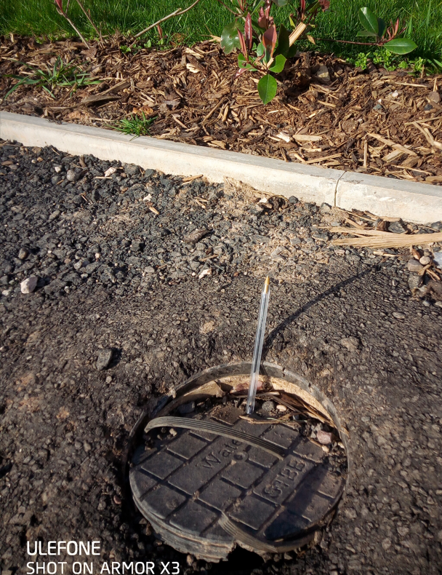
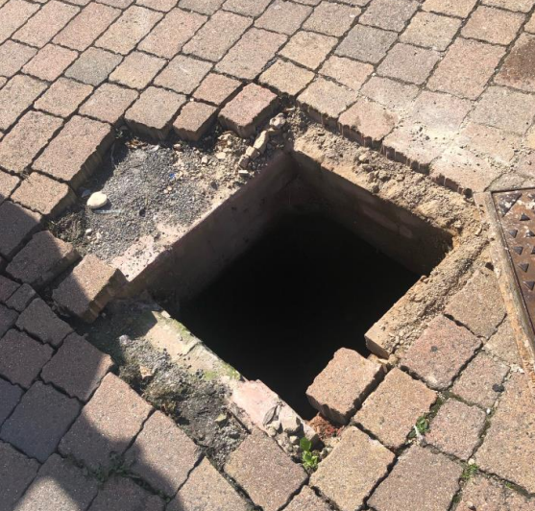
Claims from others
How claims arise

Slide 41



Claims from others
Your claims support
Sub £50,000 claims
Nominated lawyers
Claims handling agents are appointed by Persimmon to manage all the claims you receive
They are your nominated teams and are working for your best interest
They will advise on best strategies re defense, part offer, full offer, court attendances and amounts
Important to let agents bring to settle on your behalf – “arms in a mangle” hinder settlement and increase costs
Both will provide advice on liability to MD’s, will seek to defend where possible or settle on your behalf
All claims above £50,000 and all employers liability claims
Supporting Persimmon with queries or review and keeping agents to agreed KPI’s

Slide 42

Cost of Claims
You can impact the cost – up or down!

Slide 43











Cost of Claims
Claimant costs and your costs
Injury
Legal fees – the longer the claim lasts, the larger the costs
PAD - £400 every time
General Damages –
the actual injury
  Based on previous damage rulings
  Scars can be classed as disfigurement
Special Damages – everything else
  Taxi’s, travel, changes to house
  Loss of work, in-ability to work
Defend in full and ensure you have all evidence
Early settlement to keep inside “portal”
Winning at court is not always a “full win”!

Slide 44

Reducing Claims Costs
What’s in a claim?
Is trial always the best strategy?
£4,950
Injury Value
£2,500
£17,250

Slide 45
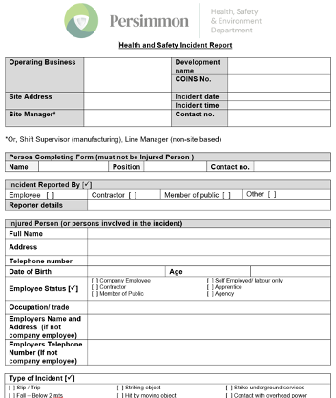
Reducing Claims Costs
Investigation is essential
Early investigation ensures early knowledge of what’s happened
Early assessment of liability and how to handle the incident
Ensures all evidence and witnesses are contemporaneous – this is critical
Retention of all evidence is imperative
Only defend those cases that you have a clear chance and all the paperwork required to win

Slide 46
Reducing Claims Costs
Successful Defense
to largest block of claims
whilst the road/paths are
still due to be laid or finished
43 claims
per year
£210,680
in claim reserves
Checks are
critical
to deny actionable defects.
Residents living on site

Slide 47






Reducing Claims Costs
Successful Defense
Paperwork – everything documented to evidence actions
Risks
assessments
Tool-box talks training, worker knowledge
PPE
Design risk out –
change job to reduce risk
Follow the Persimmon HS&E team, there is a lot of resource to support
Importantly help to ensure incidents don’t happen and our employees, customers and contractors are kept safe

Slide 48


Thank you
Any Questions

Slide 49
Leading H&S
& Persimmon
Leading H&S
MD and HODS
Barry Gorman
Group H&S Manager
Date
October/ November 2023

Slide 50
INTRODUCTION
Persimmon HS&E policy
Organisation and responsibilities
Performance monitoring and review
Our Risks
Zero Scores, why and what

Slide 51
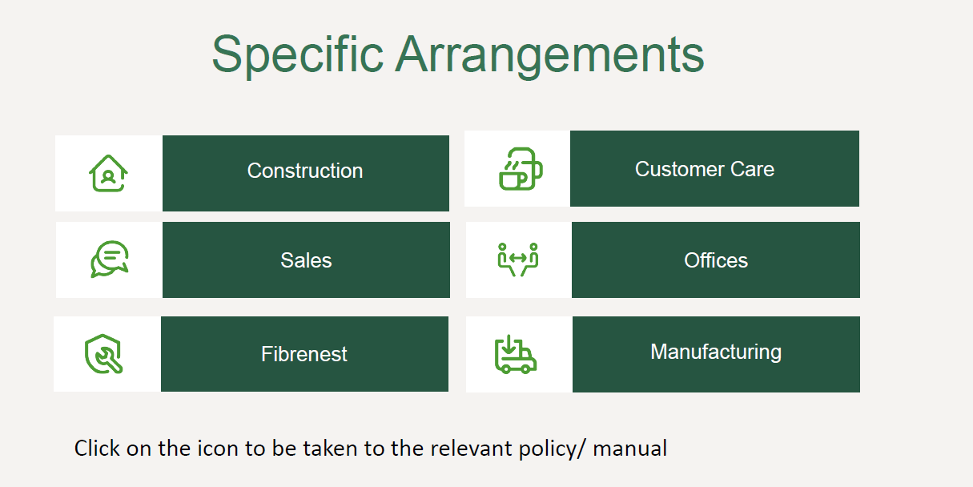
Persimmon HS&E policy
Where can you find it and what's in it?
On the Persimmon Cloud and Shared drive, contains:
Policy statements
Main policy, split into sections:
  General statement of intent
  Organisation and responsibilities
  General arrangements
  Specific arrangements (link to other policies)
Policies link to standards, guidance, forms
Other useful information:
  Training and TBT material
  Template risk assessments
  Signs and posters
  Memos and alerts
  Site inspection help card booklets
Notes:
Policy statements (one for H&S and one for environment) – Group one approved by Dean and regional one that needs to be signed by the MD. Both Group and regional Policy statements to be displayed on all work notice boards.
Sales and customer care – currently link to old manuals but will shortly be replaced with policies

Slide 52
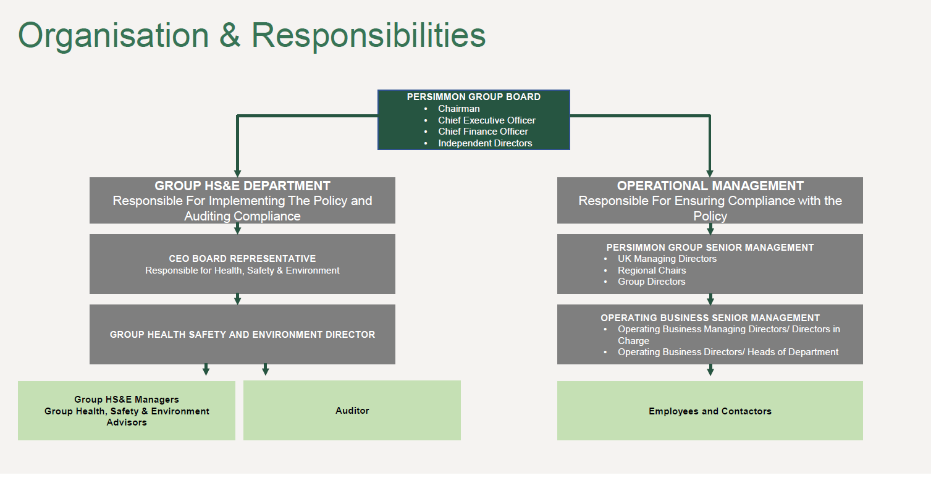
Organisation and responsibilities
This is how it is set out in the HS&E policy
Notes:
Point out where MDs/ Directors/ HOD sit in the hierarchy. Making it clear that HS&E Dept. is responsible for implementing the policy and auditing the compliance but it is the role of operational management to ensure compliance with the policy.

Slide 53
Organisation and responsibilities
Managing Directors/ Directors in Charge/ Heads of Dept. specific responsibilities
Initiate, oversee and ensure implementation of this policy within their business.
Ensure that funds, facilities and resources made available are suitably directed that the objectives of this policy are delivered at an operational level.
Ensure that appropriate arrangements are in place for effective planning, organisation, control, monitoring and review all health, safety and environmental matters.
Support health safety and environmental protection standards and performance monitoring audits.
Notes:
Make specific mention of the
Directors and Heads of Dept. Responsibility Chart and how set out allocate responsibilities in accordance with plan, do, check, act
Need to split this down so each line comes in one at a time.

Slide 54
Organisation and responsibilities
Managing Directors/ Directors in Charge/ Heads of Dept. specific responsibilities
Take appropriate action when notified of a non- compliance with this policy.
Ensure that all employees and contractors are trained and competent to carry out their roles and responsibilities.
Undertake the duties allocated to them by the Directors and Heads of department Responsibility chart.
Notes:
Make specific mention of the
Directors and Heads of Dept. Responsibility Chart and how set out allocate responsibilities in accordance with plan, do, check, act

Slide 55
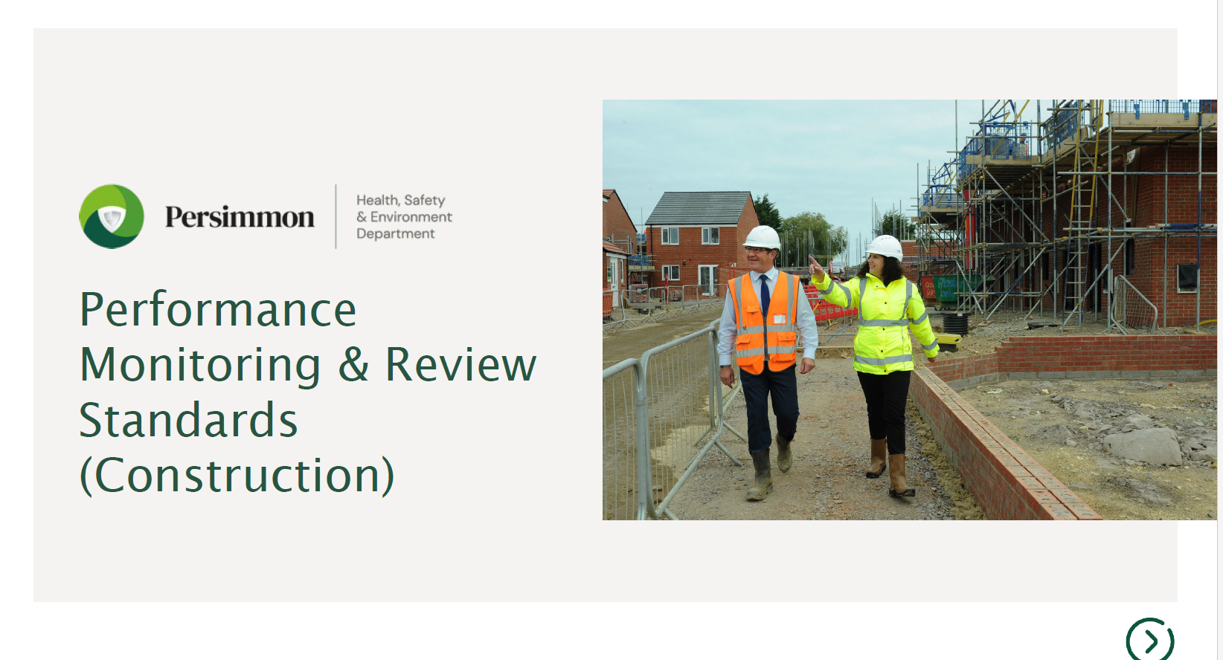
Performance monitoring and review
Specific standards for this in relation to our construction activities
These standards set out in detail everyone's roles and responsibilities:
Managing Director
Construction Director
Contracts Manager
Site Manager
Group HS&E Advisor
Senior Management
Sets out processes for monitoring and review; including, committee/ CDWG meetings, contracts manager forward planning and contractor performance review.
Notes:
Mention that other areas (sales, customer care, office) this will be covered within the policies.
MDs and CDs especially – need to have read and ensure following these standards

Slide 56
Performance monitoring and review
MD’s Roles
The Managing Director is responsible for setting the roles and responsibilities for the planning, implementing, monitoring and review of HS&E compliance. (Directors responsibility/ HOD Chart).
Chair quarterly committee meetings.
Action plan implementation and bi month review.
Quarterly site inspections with GHS&EA (As minimum).
Attend and review meetings for Zero scores, Accidents and HSE/EA/LA intervention.
Review reports.
Encourage/drive good HS&E practice.

Slide 57
Performance monitoring and review
CD’s Roles
Construction Directors must ensure that site teams undertake regular inspections and reviews of each of the sites and contractor activities under their control.
Chair the Construction Department Bi-Monthly Working Group Meeting to:
    Discuss any site issues, such as incidents and enforcement agency visits.
    Ensure that any actions are carried out.

Slide 58
Our risks
What do you think our top cause of injuries were in the first half of 2023?
Notes:
Give this commentary:
Falls from height were the highest cause of work related incidents, increasing from 5 compared to the 3 recorded for the first half of 2022.
Plant movement/ hit by a moving object accounted for 4 of the work-related incidents, increasing from the 1 recorded for the first half of 2022.
Slips and trips have dramatically reduced compared to the first half of 2022 (2023: 2, 2022: 10). This is likely as a result of the release of the new housekeeping standards and the safety campaign on slips, trips and falls at the beginning of the year.

Slide 59
Our risks
What do you think our top non- compliance (zero and one scores) issues were on site in the first half of 2023?
Notes:
Give this commentary:
Highest 3 KPIs, for zero scores:
• Respiratory protection (KPI 1.3) (25%)
• Working at height: scaffold (KPI 2.1) (17%)
• Working at height: stairwell (KPI 2.4) (10%)
Highest 3 KPIs, for one scores:
• Working at height: scaffold (KPI 2.1) (21%)
• Traffic management (KPI 5) (19%)
• Site security/ protection of the public (KPI 8) (16%)
The respiratory protection zero and one scores in this period have increased by 44%, compared to the first half of 2022. This is as a result of the HS&E team focusing on site dust mitigation measures and taking a zero tolerance approach when non-compliance seen during site inspections.

Slide 60
Our risks
HSE Notice of Contraventions – 12 so far this year with 25 material breaches What do you think these were for?
21 (84%) were following unscheduled HSE site visits:
  8 related to working at height
  3 related to traffic management
  3 related to control of dust
  2 related to keys left in plant
  2 related to welfare
  2 related to storage of materials
  1 related to site security
Notes:
Emphasis the record number of NOCs (last year only had 5, currently had 12 this year)
Also that the number of unscheduled site visits has not increased, on par with the same period last year

Slide 61
Our risks
HSE Notice of Contraventions – 12 so far this year with 25 material breaches What do you think these were for?
4 (16%) were incident led:
  3 related to working at height
  1 related to a telehandler that was used whist lifting equipment was defective
Nearly all contraventions were as a result of clear non-conformance to our Group HS&E standards.

Slide 62
Zero Scores
When are Zero Score issued?
When a Major non-conformity has been observed which is in breach of the group HS&E policy, such as:
Evidence of a risk of serious imminent personal injury.
Evidence of a risk of imminent significant environmental incident.
Evidence that no supporting paperwork can be found or significantly out of date.
If the HSE or Environmental Regulatory Authority observed the contravention they would issue a notice or commence a prosecution.
Notes:
I'm sure most of you in this room have had to deal with a zero score at some point.
I Just want to make it clear why zeros are issue and what should be done
Its better that we see and deal with an issue rather that an accident happening of the HSE, observing it and giving us a notice or closing site.

Slide 63
Zero Scores
Why Zero Scores?
Zero scores are issued to make the Operating Business Senior Management and RC aware that one of their site has a serious non- conformance, that requires their attention.
What must be done?
Immediate action required to prevent any injury - Stop Task.
Investigation carried out/ sub-contractor meeting.
A review meeting MUST be carried out with senior management highlighting the measures that have been put in place to prevent a re – occurrence.
Disciplinary action must be considered for our staff and sub-contractors.
Notes:
The HS team do issue a zero without the consent on the senior
All zereo score are reviewed by myself independently
Management and operatives at fault must be held accountable.

Slide 64
Thank you
Questions?

Slide 65

Building Safety
An Overview
Tom Weller
Group Building Safety Manager
Date
October/November 2023

Slide 66


CONTENTS
What is building safety?
Why this focus?
Legal Implications
What is being done?
Final thoughts
Relevant to all departments.
Implications for whole industry.

Slide 67
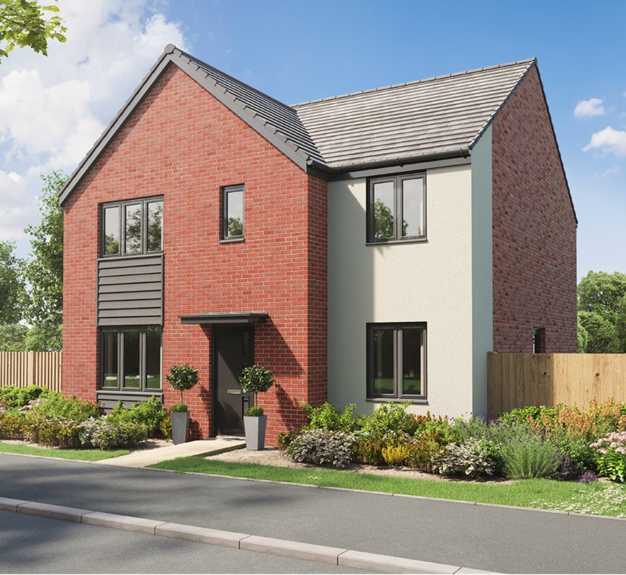
What is
Building Safety?
01

Slide 68
1) WHAT IS BUILDING SAFETY?
DEFINITION & SCOPE
Ensuring homes are safe for the people who use them.
Difference between building SAFELY and building SAFETY?
  Building safely = CDM 2015 (i.e. risk via construction phase)
  Building safety = BSA 2022 (i.e. risk via completed home)
Government definition of a building safety risk (BSA 2022):
  “A risk to the safety of people in or about a building arising from any of the following occurring as regards the building:
    Spread of fire / Structural failure / Any other prescribed matter.”

Slide 69


1) WHAT IS BUILDING SAFETY?
DEFINITION & SCOPE
Persimmon Definition of a Building Safety Risk:
“A design, build or product defect within a completed building or surrounding area, which has the potential to cause harm.”

Slide 70








1) WHAT IS BUILDING SAFETY?
BUILDING SAFETY AND THE LIFECYCLE OF THE HOME
SALES & CUSTOMER CARE
OCCUPATION & MAINTENANCE
PLANNING, DESIGN
TECHNICAL
CONSTRUCTION
COMMERCIAL & PROCUREMENT

Slide 71
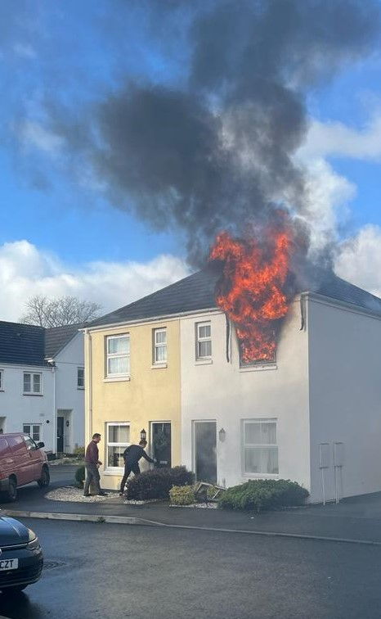
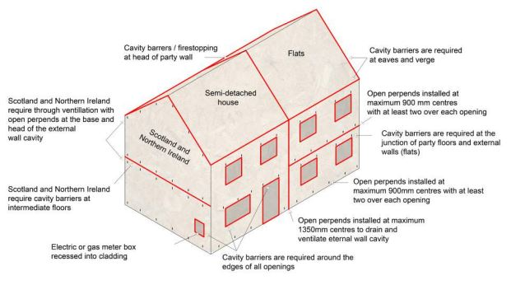
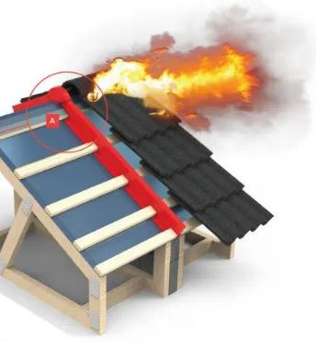
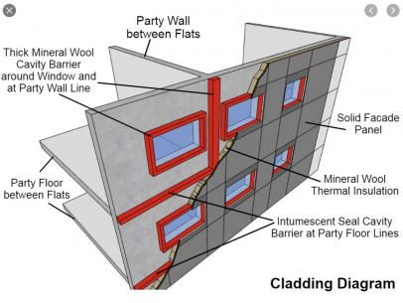
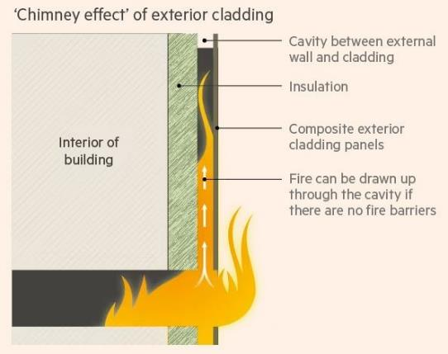
1) WHAT IS BUILDING SAFETY?
FIRE
HAZARD/RISK EXAMPLES
2022

Slide 72
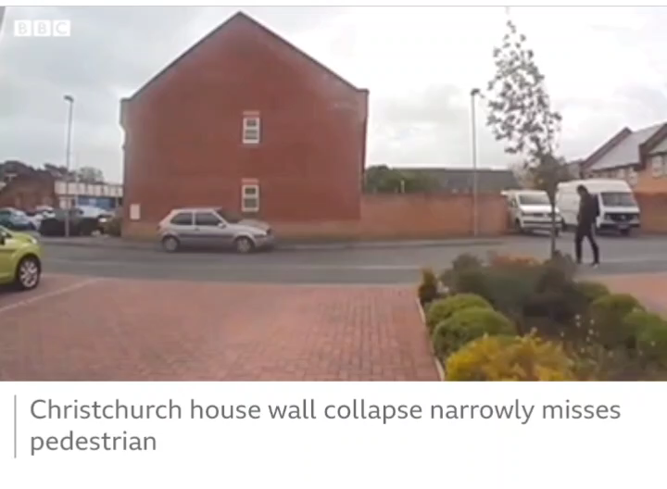
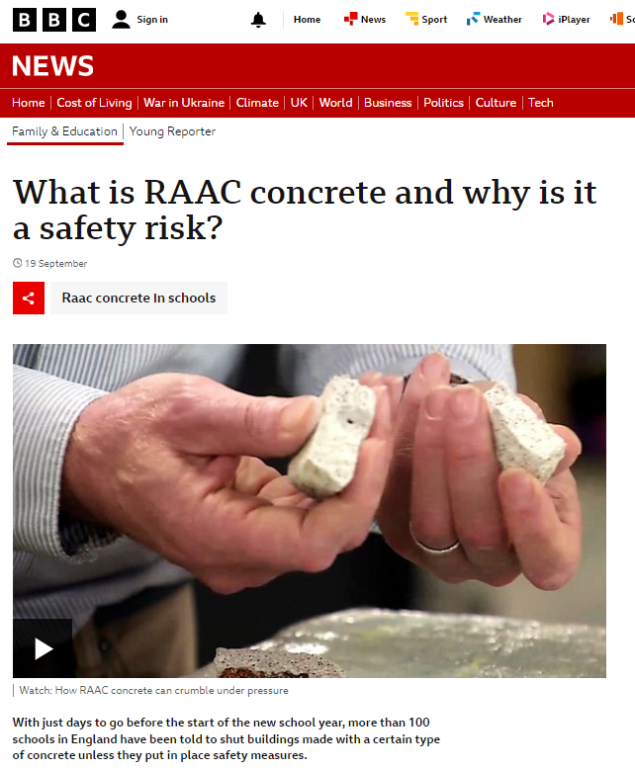
1) WHAT IS BUILDING SAFETY?
STRUCTURE
HAZARD/RISK EXAMPLES
2021
2023

Slide 73
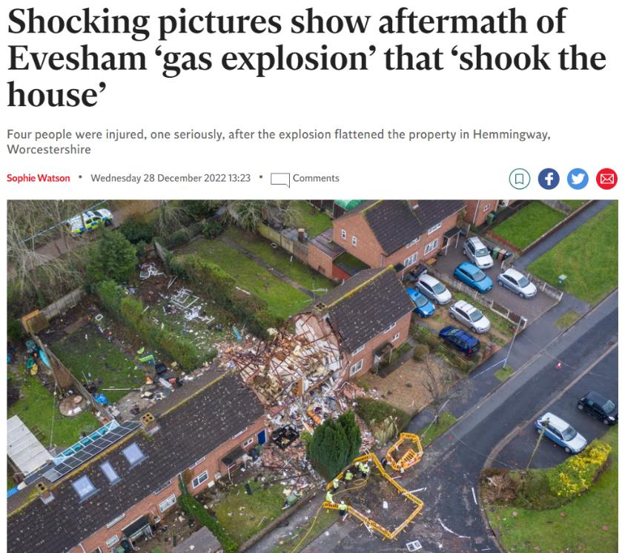
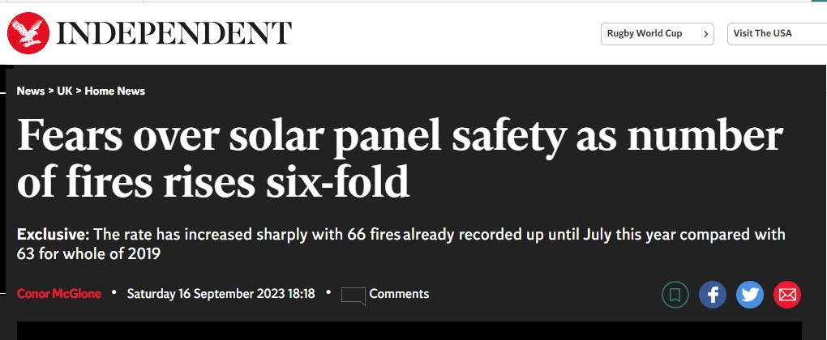
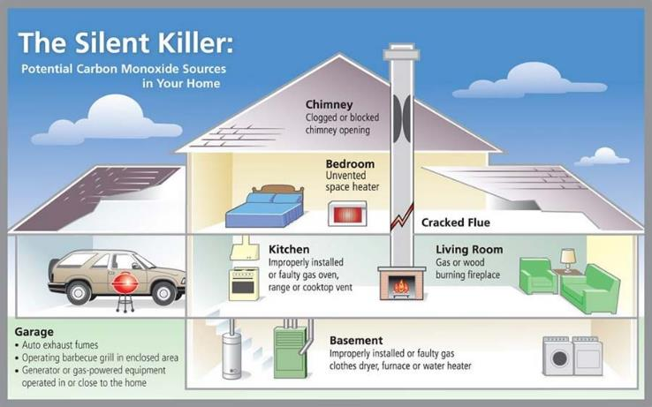
1) WHAT IS BUILDING SAFETY?
SERVICES
HAZARD/RISK EXAMPLES
2022
2023

Slide 74
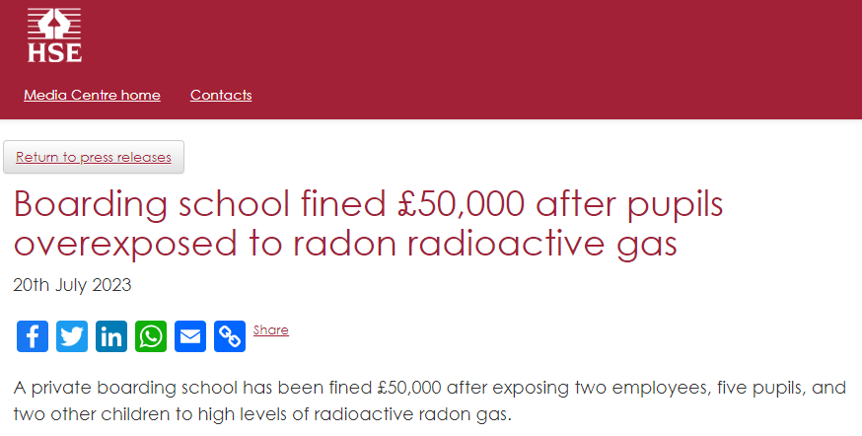
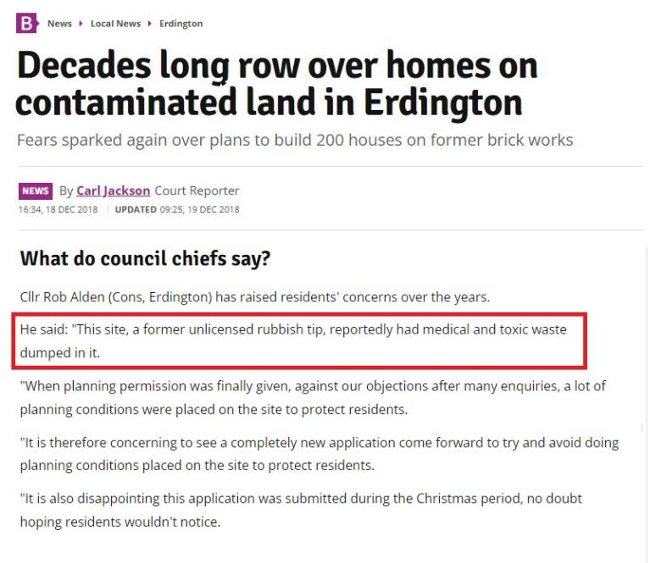
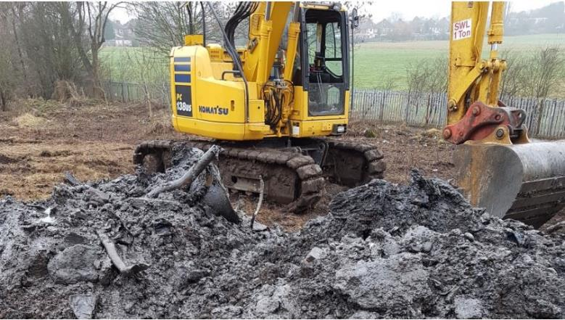
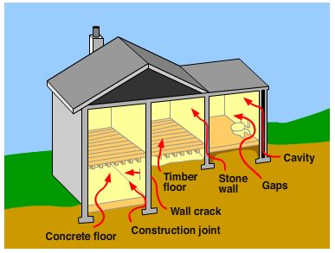
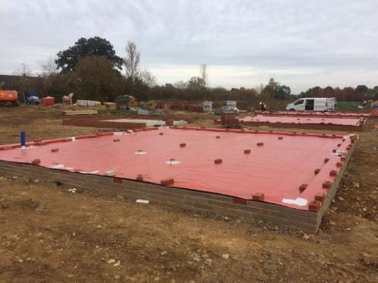
2) WHAT IS BUILDING SAFETY?
CONTAMINANTS
HAZARD/RISK EXAMPLES
2023

Slide 75

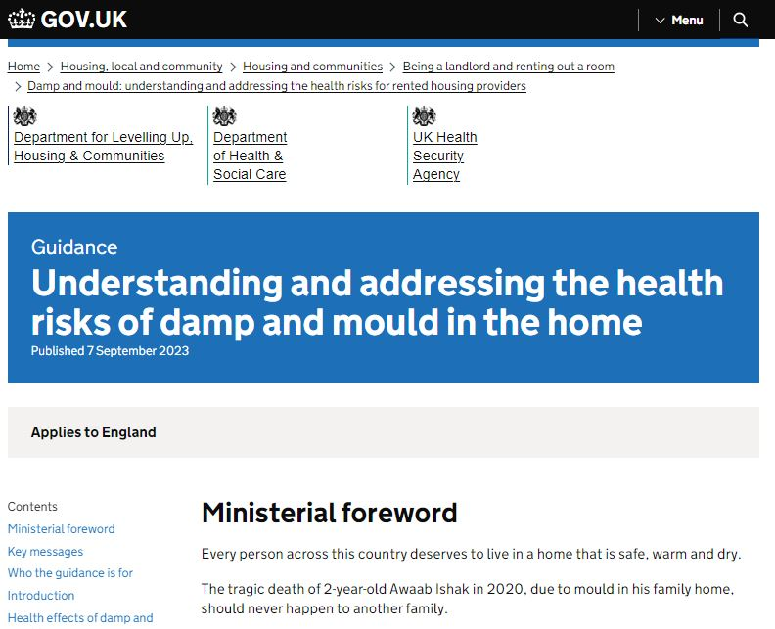
1) WHAT IS BUILDING SAFETY?
HAZARD/RISK EXAMPLES
VENTILATION / MOULD
2023
2020

Slide 76
Why this focus?
02

Slide 77
2) WHY THIS FOCUS?
AN INDUSTRY IN NEED OF CHANGE
Independent Review of Building Regulations and Fire Safety (2018) - HACKITT
  “The industry does not reflect or learn.”
  “Regulations and guidance are not always read by those who need to.”
  “The primary motivation is to do things as quickly and as cheaply as possible.”
  “Where concerns are raised, they are often ignored.”
  “The system does not facilitate good practice.”
  Current system of building regulations is not fit for purpose.”
  “Where enforcement is pursued, the penalties are so small they are an ineffective deterrent.”

Slide 78

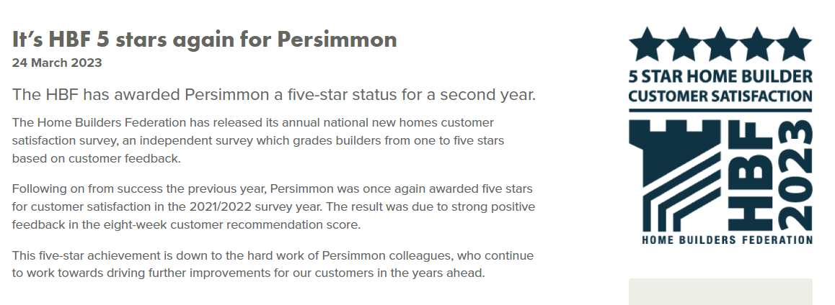
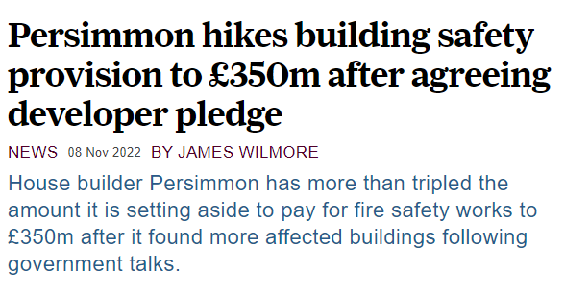

2) WHY THIS FOCUS?
AN INDUSTRY IN NEED OF CHANGE
Grenfell lessons apply to whole industry and built environment.
Corporate & Social Responsibilities:
  Moral duties
  Brand & Reputation
  Financial
  Legal Consequences

Slide 79
Legal Implications
03

Slide 80

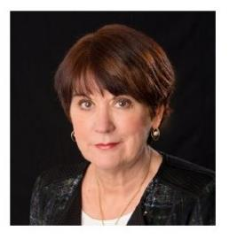
3) LEGAL IMPLICATIONS
“Let me be very clear – we are coming after you. If you do not sign, you will not be able to operate freely in the housing market.”
“I applaud the work Persimmon has done to act as a spearhead for the industry to step up and take responsibility.”
Rt Hon MICHAEL GOVE MP
DLUHC Press Release
March 2023
DAME JUDITH HACKITT
Letter to Persimmon
March 2023

Slide 81
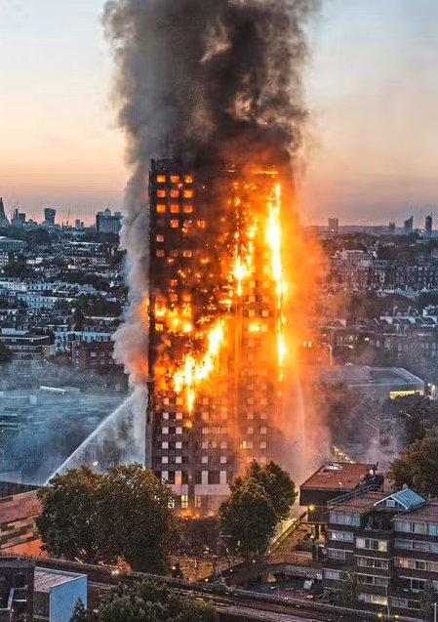
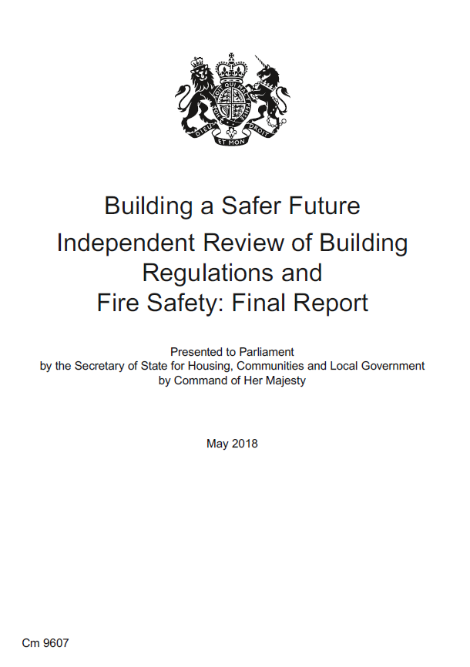
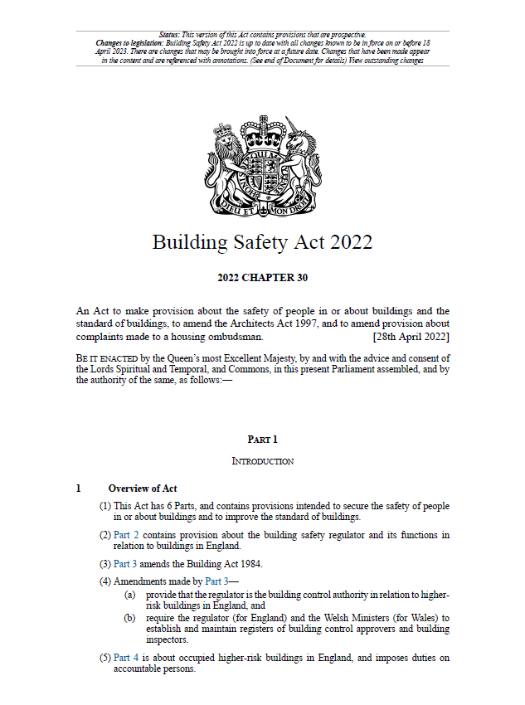
3) LEGAL IMPLICATIONS
ORIGINS OF BUILDING SAFETY ACT 2022
NEW LEGISLATION | CONTENTS
The Building Safety Act (2022) | 273 pages of primary legislation (plus 404 pages of supplementary notes)
BSA Secondary Legislation (2023) | 26 new building safety regulations (totalling 357 pages)
NOT JUST HIGH-RISE
2017
2018
2022

Slide 82


3) LEGAL IMPLICATIONS
BUILDING SAFETY ACT 2022
Prosecution / Compliance / Stop Notice / Section 36 Notice
15-year Warranties
“The person or entity that creates a building safety risk should be responsible for managing that risk”
HIGHER RISK BUILDINGS (HRBs)
(7+ storeys / 18m+ / 2+ residential units)
New Homes Ombudsman Service
Regulation of Building Control
Construction Products Regulatory Regime
Building Safety Dutyholder Regime
BUILDING SAFETY ACT
EXPLANATORY NOTES
CEO APPROVAL REQUIRED FOR HRBs
(Planning / Building / Acquisition)
Building Industry “Schemes”
Retention of Digital Information

Slide 83

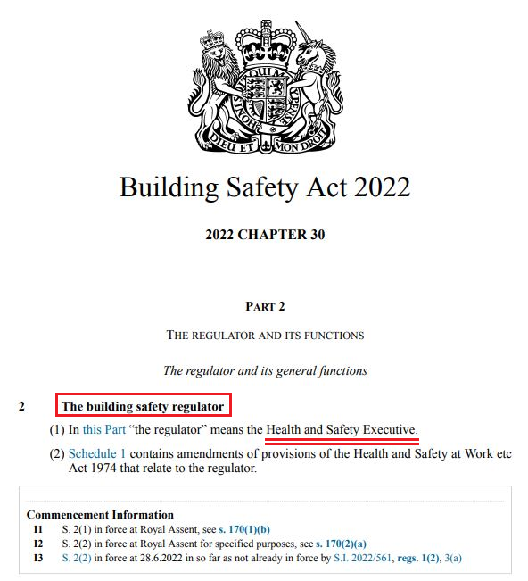
3) LEGAL IMPLICATIONS
BUILDING SAFETY REGULATOR (ENGLAND)
Duty to “secure the safety of people in or about buildings in relation to risks arising from buildings.”
BUILDING SAFETY REGULATOR (BSR)
Assist in improving the standard of buildings.
Facilitate improvements in the competence of industry.
Building Control for all Higher-Risk Buildings (HRBs).
Future activity may mirror approach to occupation H&S.
Targeted enforcement where action is needed.
Power to enter sites without warrant and seize evidence.

Slide 84
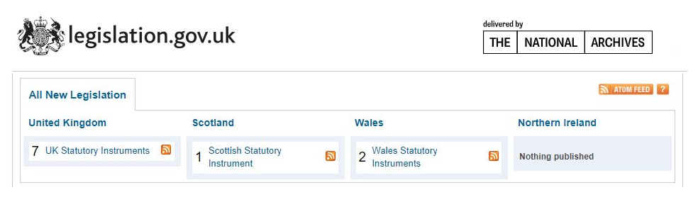
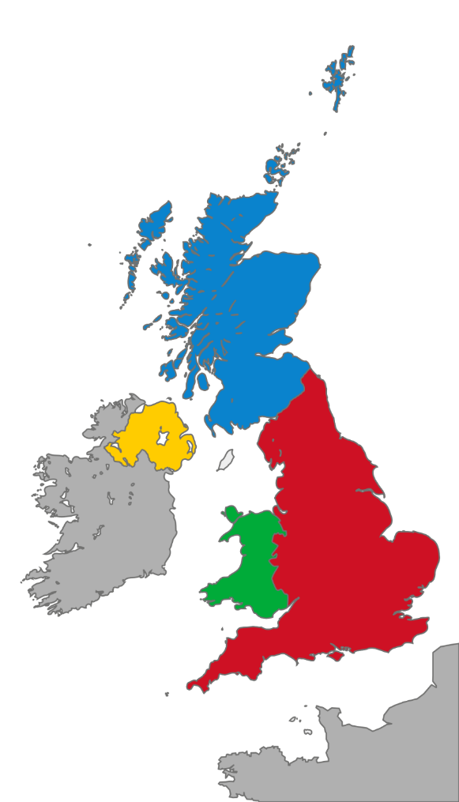

3) IMPLICATIONS
SCOTLAND
Following sections of BSA 2022 apply in Scotland:
  New Homes Ombudsman Service (s.136 – 142 & Schedule 9)
  Regulation of Construction Products (s.146-149 & Schedule 11)
  Construction Products Liability & Limitation Periods (s.151)
  Construction Products Cost Contribution Orders (s.152-155)
  Architects Act - Discipline and CPD (s.157-159)

Slide 85
3) IMPLICATIONS
DEVOLVED LEGISLATION - WALES
Many parts of BSA also apply to Wales.
The Building Safety Regulator has jurisdiction in England, not Wales.
It is anticipated that the Welsh Government will give Welsh local authorities regulatory power to oversee compliance.
The Welsh Government is expected to generally follow the Building Safety Act as it applies in England.
Ministers are in the process of deciding what is appropriate for Wales, including introducing a potential new regulator and defining equivalent duty holder roles.

Slide 86
Persimmon’s Initiatives
04

Slide 87

4) INITIATIVES
BUILDING A SAFER FUTURE
DAME JUDITH HACKITT
March 2023

Slide 88


4) INITIATIVES
“BUILDING A SAFER FUTURE” INDUSTRY SCHEME
Robust assessment, benchmarking and independent verification.
DAME JUDITH HACKITT
March 2023
BSF audit helps organisations identify potential building safety issues.
Continuous improvement plan to advance our approach as a business.

Slide 89

4) INITIATIVES
“BUILDING A SAFER FUTURE” INDUSTRY SCHEME
“All of the companies that have achieved champion status have shown the courage to look at themselves and understand the steps they need to take to improve and are now embarked upon that journey. Their leadership should be a wake-up call to everyone else to get on board”.
2023
DAME JUDITH HACKITT
March 2023

Slide 90
4) INITIATIVES
BUILDING SAFETY UNIT
DAME JUDITH HACKITT
March 2023

Slide 91
4) INITIATIVES
GROUP CONSTRUCTION DIRECTOR
ANDY FULLER
GROUP HS&E DIRECTOR
ABIGAIL BAINBRIDGE
GROUP HEALTH AND SAFETY MANAGER
BARRY GORMAN
GROUP ENVIRONMENT MANAGER
ANDREW STAUFENBEIL
GROUP BUILDING SAFETY MANAGER
TOM WELLER
Group Building Safety Unit
Group Health, Safety & Environment Department Structure

Slide 92
4) INITIATIVES
Group Building Safety Unit – Proposed Functions
Prospective
(not legacy)
Promote safety
of end-users
Policies & Standards
Identify / advise on existing and emerging risks
Updates on legal changes
Targeted audits of building safety issues
Sharing of best practice
Maintaining BSF Champion Status
Advise on training requirements
Report building safety metrics to Board
Promoting collaboration across business
Guidance / FAQs

Slide 93
Final Thoughts
05

Slide 94
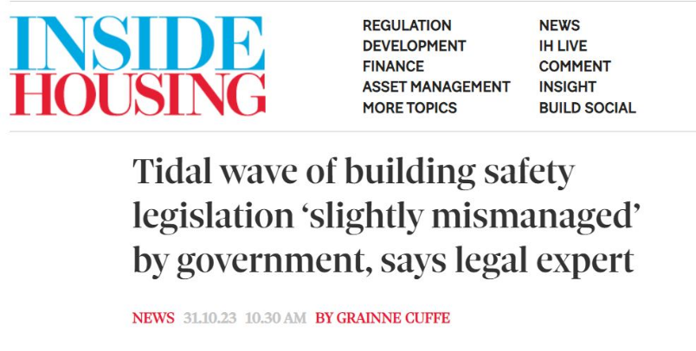
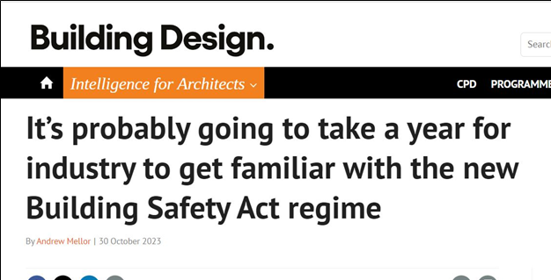
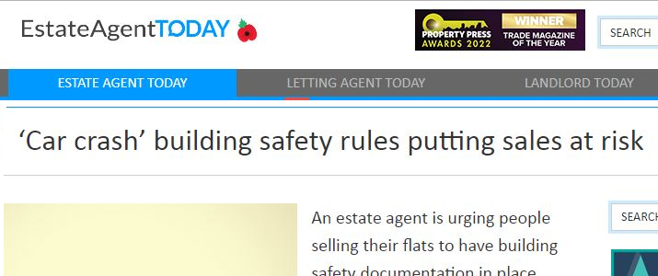
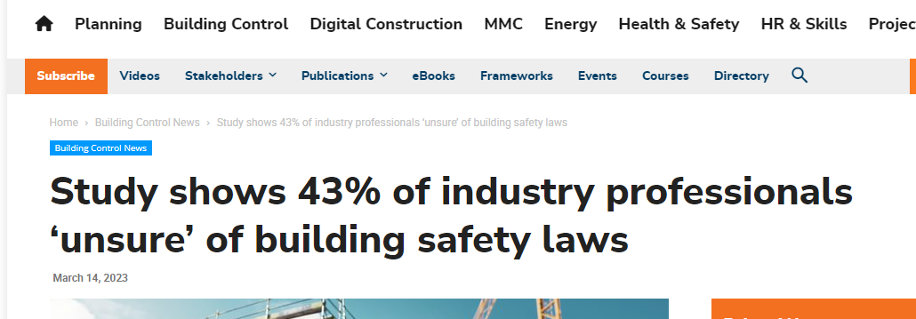
5) FINAL THOUGHTS
What does all this mean for us?
The BSA 2022 affects everyone in the industry. We are working through this together.

Slide 95


5) FINAL THOUGHTS
What does all this mean for us?
Change is coming in terms of:
  Safety Culture
  Accountability
  Responsibility
  Oversight
However, the basic principles remain the same.
  Functional requirements of building regulations remain mostly unchanged.
  Safe home is best defence.
  Get it right first time, every time.

Slide 96

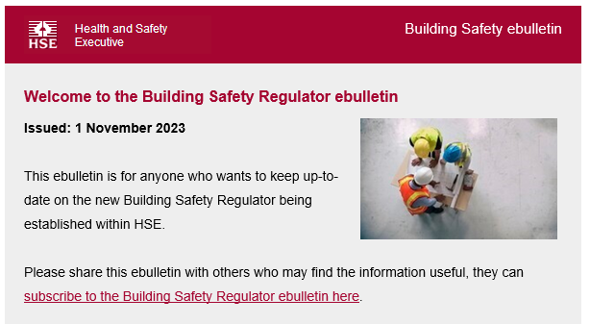
5) FINAL THOUGHTS
What can you do to prepare?
Consider your impact on the building lifecycle.
“Close the loop” with other departments.
Use the new regime as a “best practice” template.
Review document retention policies (15 years).
Digital / standardised building information.
Sign up to HSE updates and alerts.
Implement Group guidance (when issued).
Use our in-house Building Safety team (for queries, concerns, comments etc.).

Slide 97
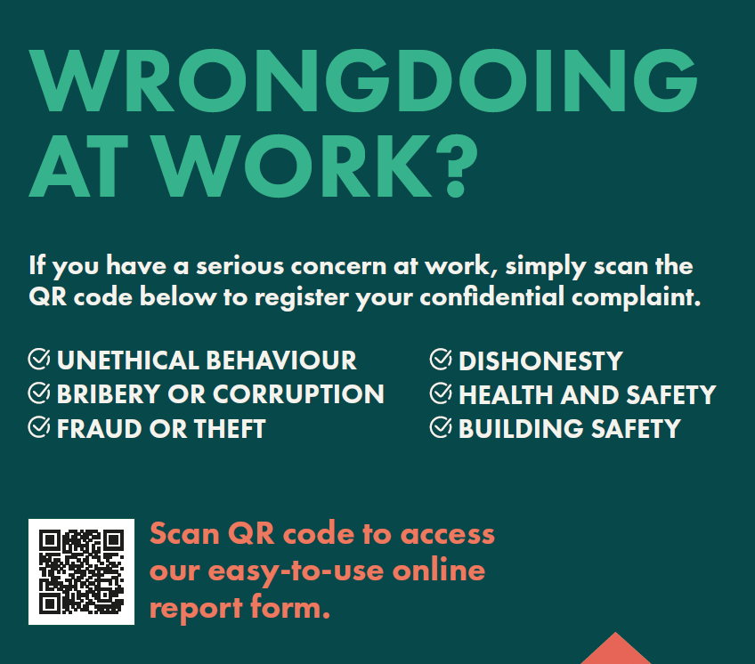
Thank You
QUESTIONS/COMMENTS:
Tom Weller
Group Building Safety Manager
tom.weller@persimmonhomes.com
07471 225 975

