Slide 1



Health & Safety Leadership Training
Abigail Bainbridge | Persimmon Group HS&E Director
Andrew Marvin | Gallagher Client Service Director
Zoom recording
Notes:
About Me
About Gallagher and services

Slide 2


Agenda
Leading Health & Safety/
Health & Safety Performance
Essential Principles
State of Nation
Responsibility

Slide 3

State Of Nation
HSE Construction statistics in Great Britain, 2022

Slide 4


State Of Nation
Fatal Injuries
30 fatal injuries to workers
and 5 members of the public in 2021/2022
Source: RIDDOR, 2021/22

Slide 5
State Of Nation
Non-Fatal Injuries
59,000 non-fatal injuries to workers averaged over 3 years. 2019 - 2022
Source: Labour for survey (LFS)
Notes:
Labour Force Survey 32,0000 households
STFs less than other sector but more injuries from falls from height in the construction sector

Slide 6

State Of Nation
ILL HEALTH
Other
20%
Musculoskeletal Disorders
53%
27%
Stress, Depression, Anxiety
78,000 workers suffering from work-related ill health (new or long-standing)
Averaged over the three-year period 2019/2021/2022
LFS estimated annual average 2019/2021/2022
Notes:
SDA has taken over from Musculoskeletal in other it is through construction will follow suit
In our discussions with others when undertaking this training, agreed that it was probably that less people are suffering with SDA, its just under reported. Construction is a male dominated sector, with men who don’t like to talk about their MH, we need to break down those barriers.

Slide 7
State Of Nation
Work-Related Ill Health
Source: LFS, estimated annual average 2019/20-2021/22
Notes:
The black lines are the range the HSE are saying the rates could actually be as based on a survey not all reported cases

Slide 8
State Of Nation
Musculoskeletal Disorders
There were an estimated 42,000 work-related cases of musculoskeletal disorder (new or longstanding) 53% of all ill health in the construction sector.
Source: LFS, estimated annual average 2019/20-2021/22

Slide 9
State Of Nation
Stress, Depression, and Anxiety
An estimated 21,000 work-related cases of stress, depression or anxiety (new or longstanding) 27% of all ill health in construction sector
Source: LFS, estimated annual average 2019/20-2021/22
Notes:
At any given time 1 in 6 working age adults have symptoms associated with poor mental health,
1 in 4 people experience poor mental health each year
72 million days lost costing UK £45 billion each year

Slide 10
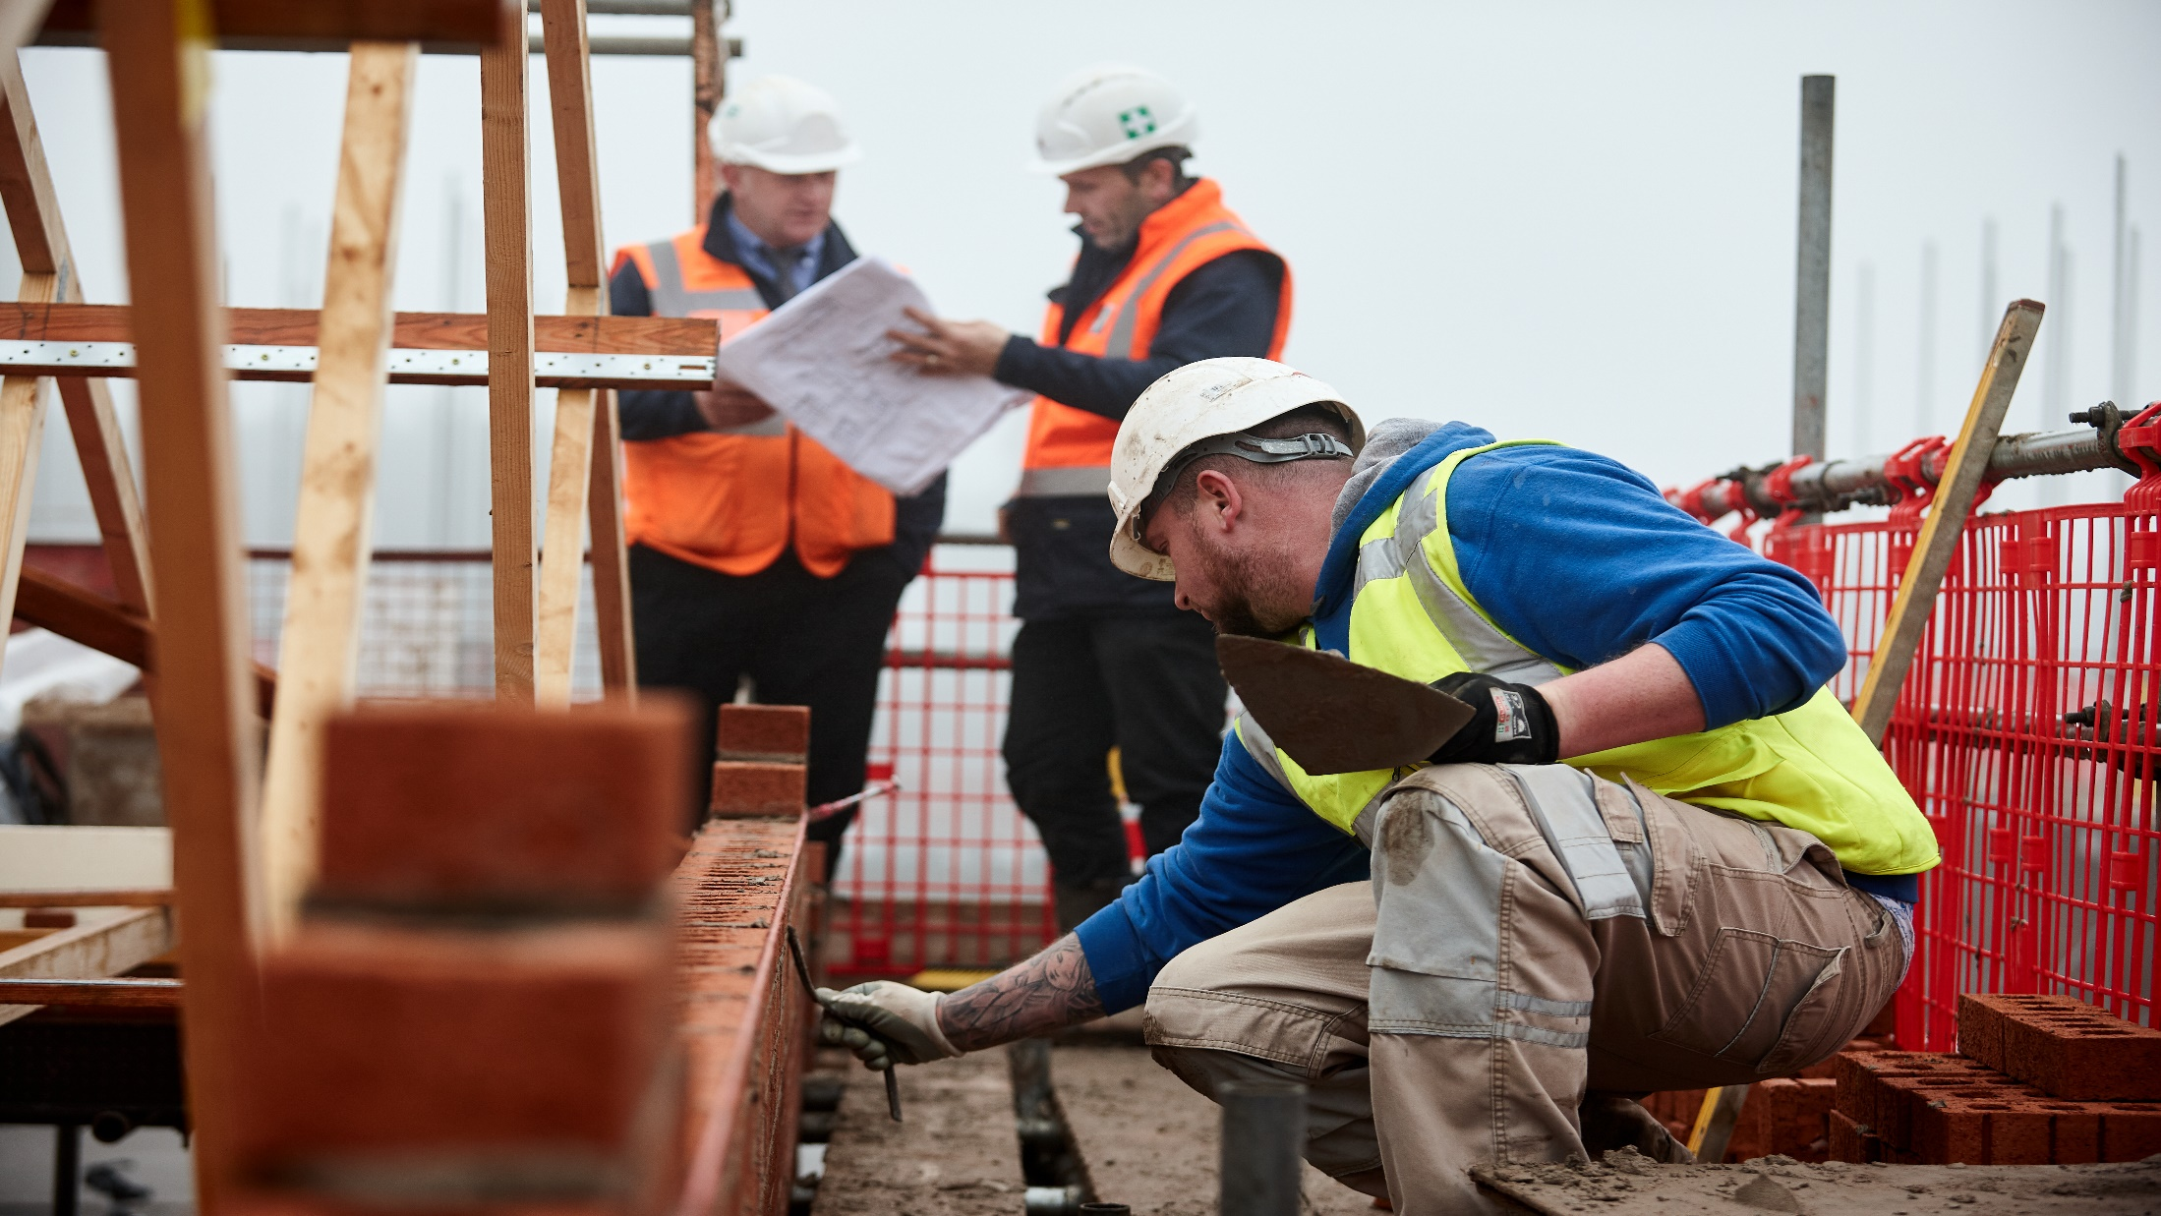
Responsibility

Slide 11



Responsibility
Reasons for Safety
Financial
Legal
Moral
Insured & Uninsured
Civil & Criminal

Slide 12


Responsibility
Moral
Right Decision
Wrong Decision
Responsibility
Notes:
Everyone has a right to go home safe at the end of each day. No one wants to break the news to a spouse or parent that their loved one has been injured whilst at work.

Slide 13
Responsibility
Reputational Damage
Damage to reputation is far more costly than a material loss of an accident
Customer Impact
Workforce Confidence
Associated Guilt
Market confidence & share price
Notes:
In the four years I have been at Persimmon, each year more questions from shareholder groups on out H&S stats.

Slide 14




Responsibility
Legal
Civil Law
Criminal Law
Directors Disqualification
Companies Act 1985 (UK)

Slide 15
Responsibility
Civil Law
Common Law
Liability
Duty of Care
Breach of Duty
Harm caused by Breach
Training & Competent Staff
Maintenance
Document Disclosure
Energetic Safety Campaign

Slide 16
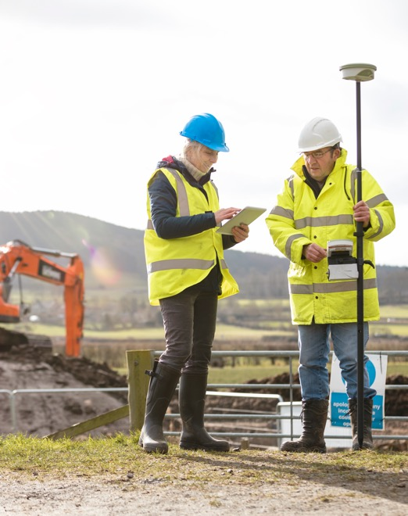
Responsibility
Criminal Law
Section 2
Employers Duty
Section 3
Duty to non-employees
Section 6
Manufacturers and Suppliers Duty
Section 7
Employees Duty

Slide 17

Responsibility
Board Members and Directors Responsibility
Criminal Law
Health and Safety at Work (etc.) Act 1974
Section 2 & 3 – Employers duty to employees and non-employees
Offence committed by corporate body
Offence is caused by Director or senior manager through their
  Consent
  Connivance
  Neglect
  Consequence
  Company - Enforcement Notices or unlimited fine
  Individuals – fine or imprisonment (max 2 years)
Notes:
Fine based on turnover – as it needs to send the message home. We know from previous cases that organisations which greatly exceed the 50 million turnover threshold for a large organisation get significant fines. Level of culpability is taken into account but fines usually in the millions.

Slide 18

Responsibility
Board Members and Directors Responsibility
Employer Obligations
Health and safety policy
Risk assessments
Manage health and safety
Access to competent health and safety advice
Provide employees with information, instruction, training and supervision - must be competent for their work
Consult with employees

Slide 19
Responsibility
Board Members and Directors Responsibility
Criminal Law
Company Directors Disqualification Act 1986
Convicted of indictable H&S offences
Disqualification order for up to 15 years
HSE will remind the court of its powers to make a disqualification order
Notes:
Named Directors on companies house.

Slide 20
Responsibility
Board Members and Directors Responsibility
Criminal Law
Unlimited fines
Corporate Manslaughter and Corporate Homicide Act 2007
Failure in management systems
Failing at senior level
Cultural issues
Gross negligence “Far below what was reasonably expected”
Failure to manage caused death
Remedial
Orders
Publicity
Orders
Notes:
Publicity order – is basically asking the company to pay to publicise their own failings.
Corporate Manslaughter prosecutions are still quite rare and are difficult to prove against larger organisations due to the number of reporting lines between senior management and work on the ground.

Slide 21
Responsibility
Board Members and Directors Responsibility
Employer Obligations
Companies Act 1985 as amended 2005
Directors duty now includes - “to take all reasonable steps to ensure the company acts in accordance with obligations” e.g. to comply with H&S law
Directors of ‘large’ companies to appoint a ‘health and safety director’ to keep .... directors informed on company H&S issues
HSE and IOD ACoP on how directors can comply with this duty - See INDG 417
Notes:
IOD ACoP referenced in our performance management standards

Slide 22
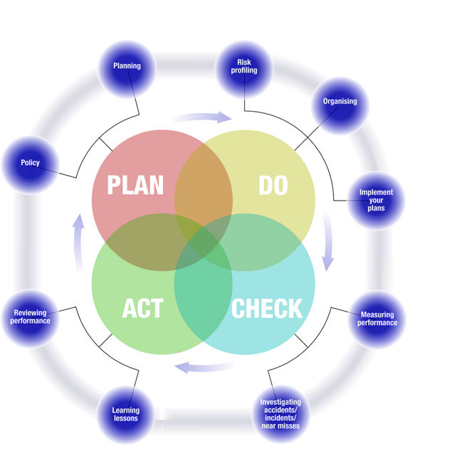
Responsibility
Board Members and Directors Responsibility
IoD and HSE Guidance
Guidance by Institute of Director and HSE
“Leading health and safety at work”
Also links in with ISO 45001
All are based on “PDCA”
  Plan
  Do
  Check
  Act
Notes:
Our HS&E policy is based upon plan, do, check, act.

Slide 23


Responsibility
Board Members and Directors Responsibility
Directors Duty - protect business & stakeholders from risk
H&S
Customers
Environmental, Social and Governance ESG
BUSINESS
Costs
Suppliers and Manufacturers
Environment
Notes:
H&S feeds into our ESG, as said earlier, becoming ever more important for shareholders.

Slide 24

Leading Health & Safety
Health & Safety Performance

Slide 25





Leading Health & Safety
Health & Safety Performance
Leading Health & Safety
Planning
Health & Safety Policy
Organisation
Arrangements
Planning
Setting health & safety objectives
Operating Rhythm/ Integration /Culture

Slide 26
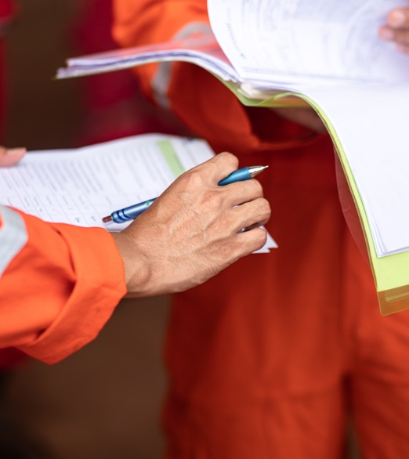
Leading Health & Safety
Health & Safety Performance
Leading Health & Safety
Policy Statement
The priorities, plans and targets of the business or organisation
The requirements of current (and new) law.
Think about where you are now and where you need to be
Say what you want to achieve
  who will be responsible
  how you will achieve your aims
Decide how you will measure performance
Periodic review and updating

Slide 27
Leading Health & Safety
Health & Safety Performance
Leading Health & Safety
Clearly identified roles and responsibilities of-
Top Management
Setting policy and providing management for H&S
Resourcing
Setting objectives and targets
Health and safety director duties
Line Managers
H&S management of their own areas
Risk assessment, control, training and monitoring
Supervisors
Day-to-day implementation and enforcement

Slide 28
Leading Health & Safety
Health & Safety Performance
Leading Health & Safety
Health & Safety Objectives/KPI’s
H&S objective is the intended achieved performance
KPIs set the way of measuring it
Examples
Undertake targeted safety campaigns to improve KPIs that are under performing
Review near miss data for trends and make any necessary changes to policies and procedures
Introduce an incentive/ reward for good H&S performance

Slide 29
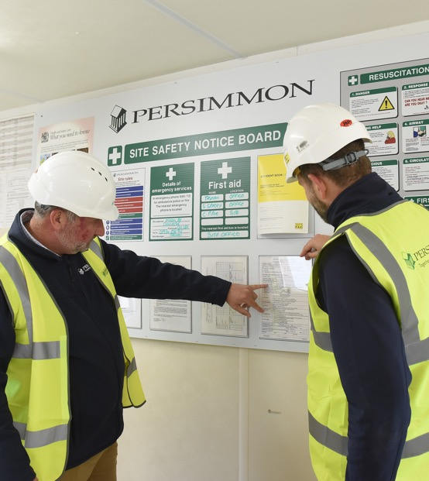
Leading Health & Safety
Health & Safety Performance
Leading Health & Safety
Health & Safety Resource Required
Expertise/ competence
  Board level/ senior managers
  Line managers
  Employees
Time to manage H&S
Support from business
Money for making improvements
Notes:
Having access to H&S Advisors is not just a business nice to have but a legal requirement.

Slide 30




Leading Health & Safety
Health & Safety Performance
Leading Health & Safety
How do we do this?
Involving Employees
Employees know the risks at work and how to reduce them
You need their knowledge and help to Identify concerns
Find practical improvements
Agree safe systems of work and comply with them
Review assessments and consider changes
H&S Committee, consult & communicate openly respond to questions, concerns, etc
Demonstrate goodwill and trust
Discuss H&S informally when on shop floor
Accept help – nobody knows it all.

Slide 31
Leading Health & Safety
Health & Safety Performance
Leading Health & Safety
Measuring Performance
Reactive Monitoring
Monitors the past
Proactive Monitoring
Monitors what is happening now
The Future
Monitoring provides information on what we may need to respond to

Slide 32

Leading Health & Safety
Health & Safety Performance
Leading Health & Safety
Key Performance Indicators
Setting of H&S KPIs
Appropriate for organisations needs
Proactive and Reactive
Creates focus and awareness
Monitored by board &/or H&S committee
Reviewed and set annually
Publicised as part of H&S awareness campaigns

Slide 33
Leading Health & Safety
Health & Safety Performance
Leading Health & Safety
Safety Culture
Values
Leadership
Ownership
Communication
Notes:
All things we continually look at and try and improve upon

Slide 34

Essential Principles

Slide 35
Essential Principles
Leading Health & Safety
Essential Principles
Strong and active leadership from the top:
Visible, active commitment from the board;
Establishing effective ‘downward’ communication systems and management structures;
Integration of good health and safety management with business decisions.
Worker involvement:
Engaging the workforce in the promotion and achievement of safe and healthy conditions;
Effective ‘upward’ communication;
Providing high-quality training.
Assessment and review:
Identifying and managing health and safety risks;
accessing (and following) competent advice; monitoring, reporting and reviewing performance

Slide 36


Thank you
Any Questions

